Slide 3
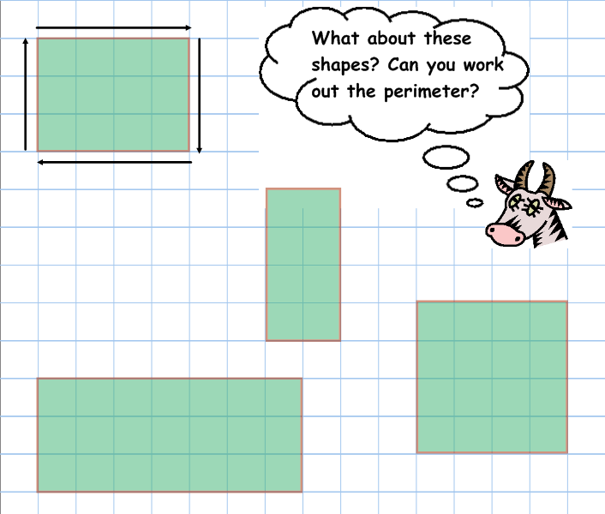

Slide 7
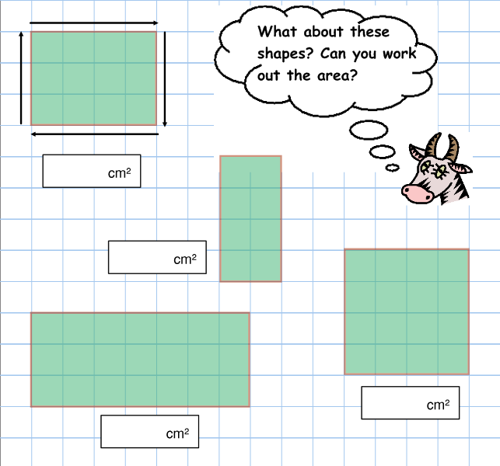

Slide 8
16.6.20
To carry out an investigation involving area and perimeter.

Slide 9
Area and perimeter
What’s the area of this rectangle?
What’s the perimeter of this rectangle?
10cm
5cm

Slide 10
Area and perimeter
What’s the area of this rectangle?
What’s the perimeter of this rectangle?
8cm
7cm

Slide 11
How many rectangles have an area of 12cm²?
12cm
All of these rectangles have the same area, but do they have the same perimeter?
1cm
6cm
2cm
4cm
3cm

Slide 12
P
E
N
T
O
M
I
N
O
E
S
6 x 10

Slide 13
More of that later!
Poly-ominoes
Many-squares
Rules
✓
Full edge to edge contact only.

Slide 14
P
O
L
Y
O
M
I
N
O
E
S
Mon-omino
Domino
Triominoes
1
1
2
Find all of the?
Tetrominoes
Think systematically!
Don’t forget to avoid duplicates. Remember, rotations and reflections are not allowed!
?
?
5

Slide 15
P
E
N
T
O
M
I
N
O
E
S
The pentominoes have lots of interesting properties. Find and draw all of the pentominoes.? Don’t forget to think systematically!
12

Slide 16
Plenary
Do you need to draw all the rectangles to work out how many could have an area of 20cm²?

